Slide 1
Coding with a Baby
Lessons learned from a developer with small children

Slide 2
Techniques


Slide 3
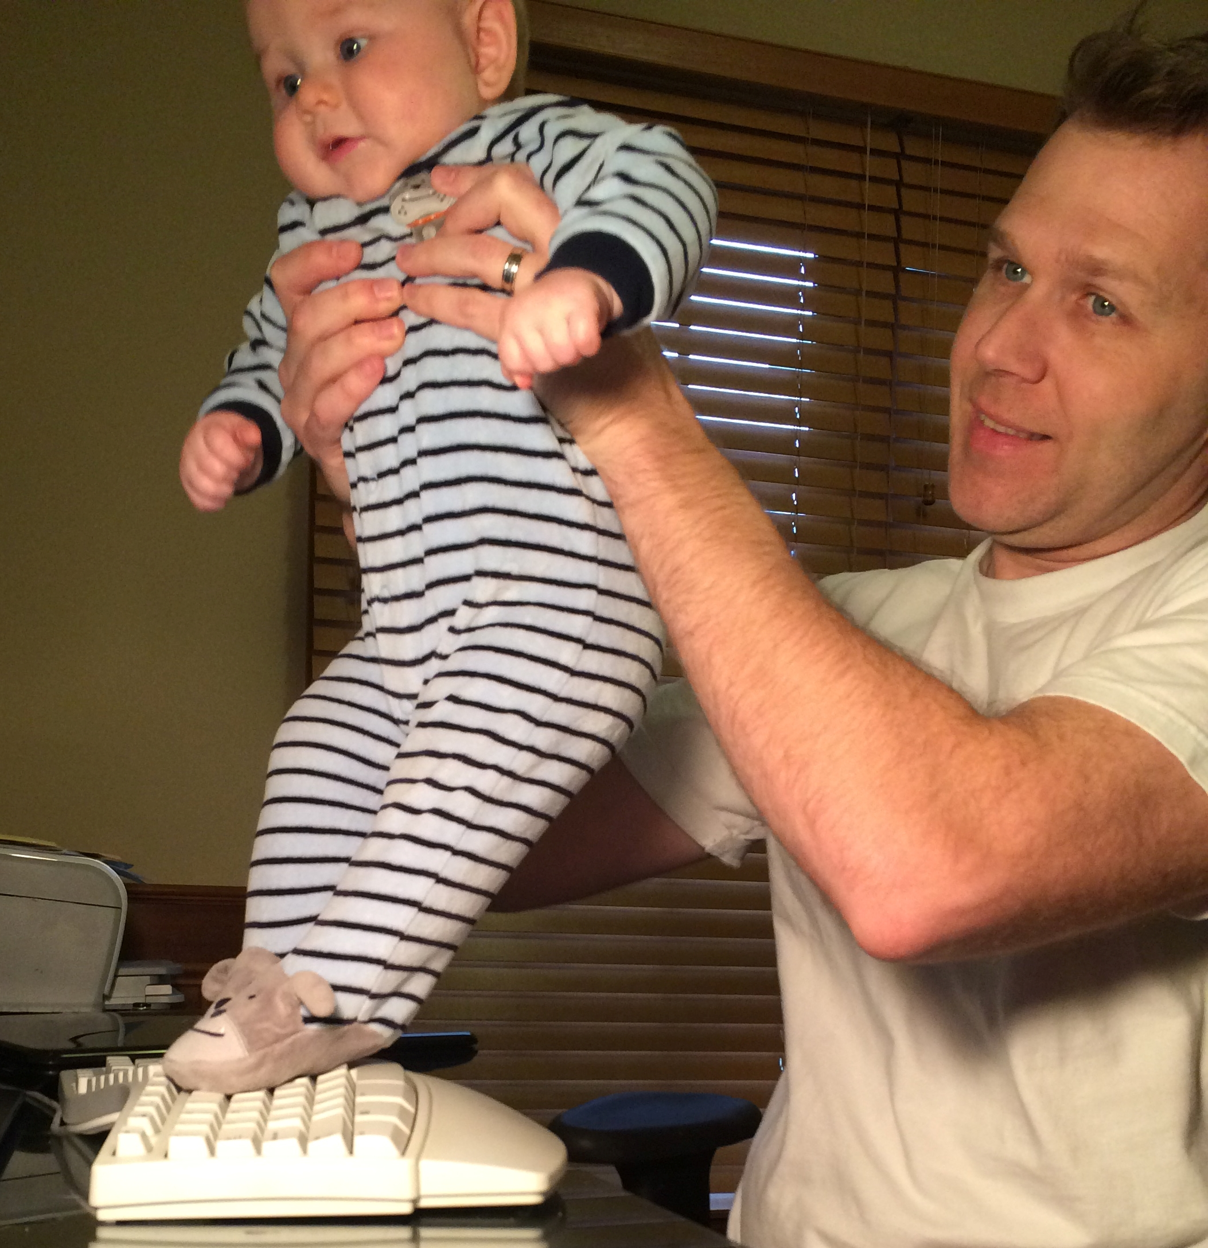
Techniques

Benefit
Tiny toes can precisely touch keys
Drawback
Need head control, so must be older

Slide 4
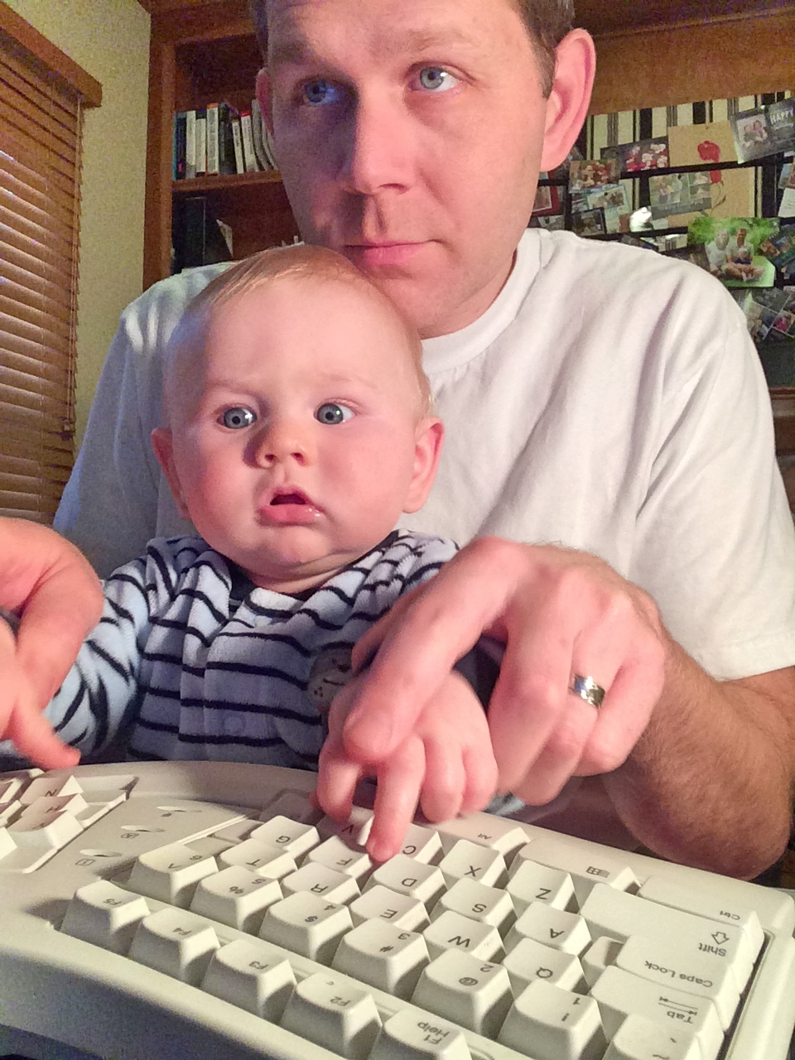
Techniques

Benefit
Very precise
Drawbacks
Need head control and finger control
Realization the baby knows more than you

Slide 5
Thanks


Slide 6
Outline
Bio
Career
Resources
Children & Technology

Having the Baby


>

1
2
3
4
5
Notes:
Explain the title bar movement
Shout out to Cassandra Faris
How Technology Can assist from pregnancy through the first days of child's life
How manage career expectations, time, and continuous learning (How to remain effective in your career while still spending time with your family)
Discussion of topics related to children and technology
Ultimately => Having a baby is a wonderful experience, which impact your life in many ways, with some planning and hard work you can be successful in your parenting and career

Slide 7
Bio


Slide 8

Bio

HMBer
Father of 2
Married to a patient wife
Software Enthusiast
14 years of .NET Experience
Enterprise Architect
Developer
Scrum Master
Life Learner
① https://twitter.com/CognitiveBurden
 https://github.com/cognitiveburden
 cognitiveburden@gmail.com
Jim Everett
Developer, Architect, Software Enthusiast
Notes:
Worked in fortune 50 company
Consulting
Federal Government
Local Government
Small business
I prefer to work for a company where I am not a cost center, but a revenue generator.
I believe this changes how developers interact with business
Many companies have not come to the conclusion that their core competencies are in technology
I enjoy working for HMB, if you have questions about HMB or its culture please feel free to talk to me or the (recruiter) sitting down in the front.

Slide 9
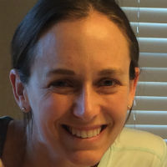


Bio

B
R
G
The Wife
The Big Brother
The Baby
Notes:
Note: I am not naming the children with their full names this is something we will dive into during the children with technology section

Slide 10
Having a Baby
>
Notes:
You and your spouse created a tiny human. Despite all the software you have written, the child will be your greatest creation.
Sections
Pregnancy
Reducing project impact
the Delivery
Early Days with the baby

Slide 11
Pregnancy
r
Notes:
There is a real sense of accomplishment knowing you created life.

Slide 12
Pregnancy
r

Debugging in Production
Notes:
You quickly realize you are going to be debugging in production
Its like have a test suite where the names of the tests are A, B, C, 3, 4, 5…yes you will know there is a problem because the baby is crying, but that no idea what is wrong.
I guess you could say my first child is the Prototype for the second child, but I think there was more design and planning for the first
So how do you overcome the difficulty of debugging in production?
Research
Practice
And of course technology can help

Slide 13





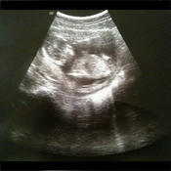

Pregnancy
r
My Pregnancy Today
Pregnancy Weight Calculator
Baby Names !!
BabyList Baby Registry
Baby Kicks Monitor
Full Term – Labor Contraction Timer
Baby Bookie
Notes:
Really want to give you a peek at what is out there to help
Selfies every week to view bump progress
Birth Planner
Daily Updates on Baby
My Pregnancy Today | Baby Center
Weight Gain App
Pregnancy Weight Calculator & Baby Bump Weight Gain from Mobile Mom
Contraction Timer
Full Term – Labor Contraction Timer
Kick Counter
Baby Kicks Monitor
Baby Registry
BabyList Baby Registry
Baby Names App
Baby Names!!
Due Date Pool
Baby Bookie

Slide 14
The Delivery
t
Notes:
Story of the second baby…point you need to listen to the mother to be

Slide 15
t
The Delivery



○
Entertainment
Music
Chargers
Announcement
Notes:
Announcement
Email
Have prepared email with open areas for Full Name, length, weight, time born.
Include an appropriate picture
Facebook or other social media
Be careful about providing too much information about the baby
Maybe just call it baby Everett with stats
Just FYI no one wants to see tweets on how many cm dilated you are!
Service
Bornyet.com
Will let you have custom url for people to monitor
Create a list of people to email
Allow quick upload of picture and info then it does the work for you

Slide 16
The Result
3

Slide 17
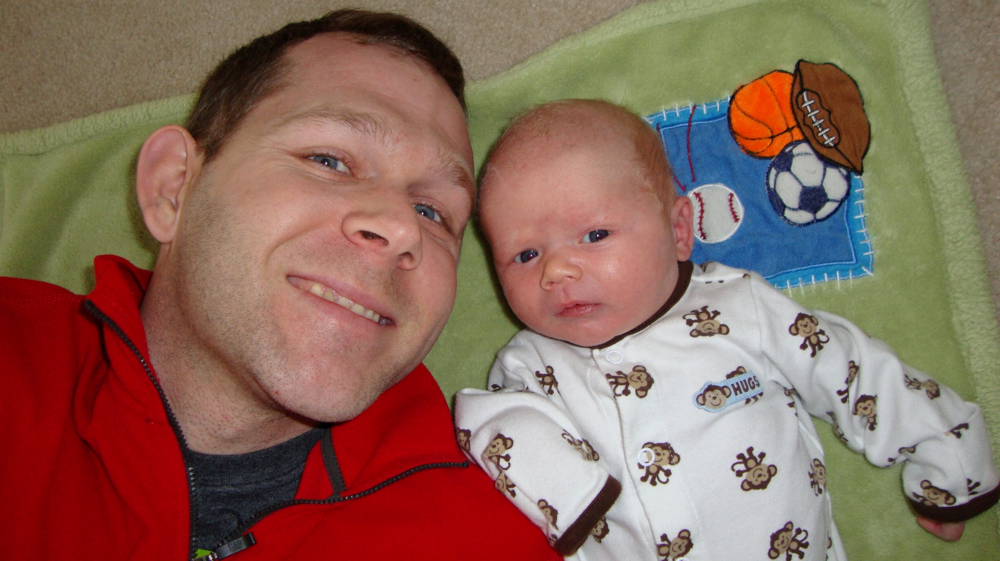
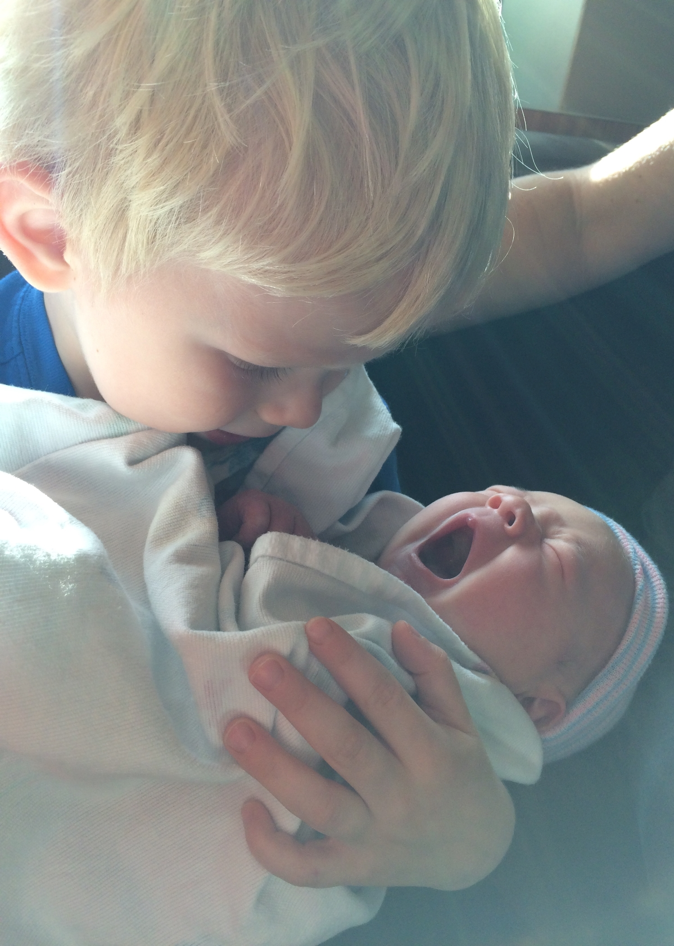
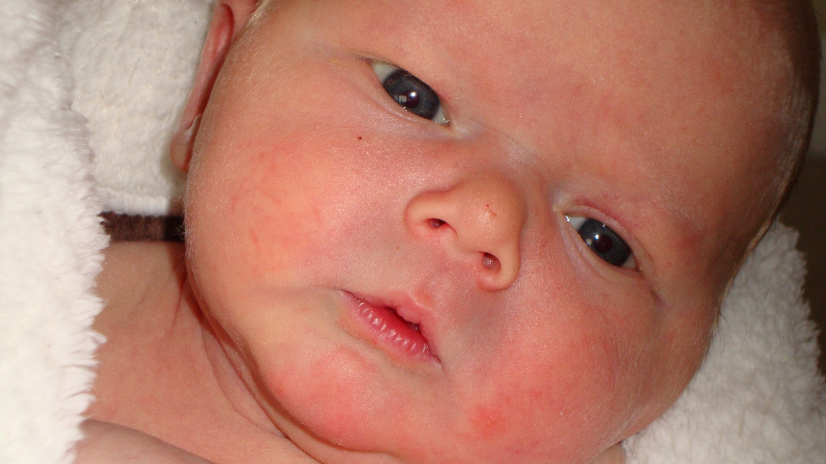
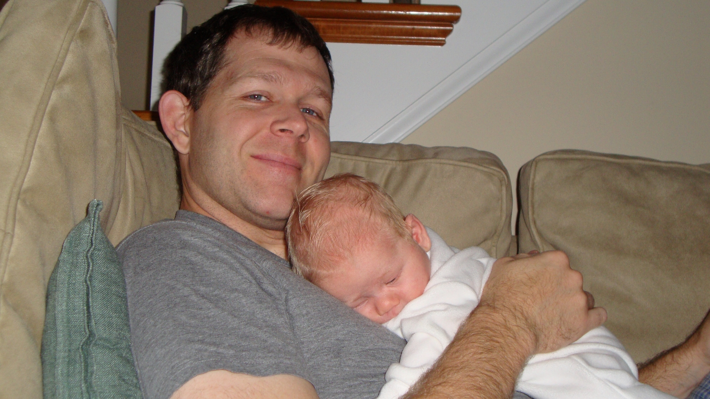
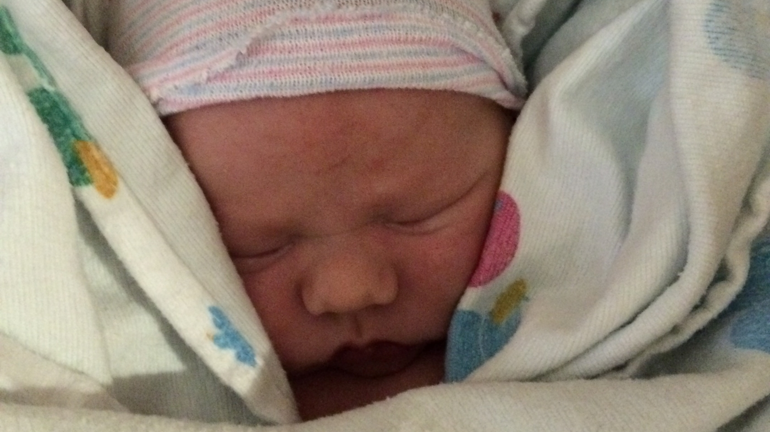
The Result
3
Notes:
Don’t know if you can tell but I have a lot more grey hairs in the second one

Slide 18
Early Years
@

Slide 19




Early Years
@



Baby Tracking
Journaling
Safety

Track Feeding, Diapering, Sleeping, & Growth
Provide charts and graphs on baby’s progress

Keep track of all your child’s milestones
Mixes pictures, dates, and stories

Apps to help keep your baby safe.


Notes:
Baby Tracking
When you first get out of the hospital you are given a sheet to monitor feeding, diapering, and sleeping, which the nurses use to monitor baby
There are apps which help you track this
We used MammaBaby because it had some nice feeding timers and would sync across multiple devices, so I could time or Grandma could time
Journaling
For the first baby we created a hard copy baby book
For the second we used a journaling service, you put in events as they happen and you can view them online, or get book created
LifeCake and DayOne are two such apps
LifeCake is specific to children and DayOne is more about journaling your life
Safety
Remember Nationwide's controversial super bowl commercial about the boy dyeing?
Well at least they created an app to help make your house safer, including checklists

Slide 20
Geek Out
⬅
Notes:
Got to have the gadgets

Slide 21
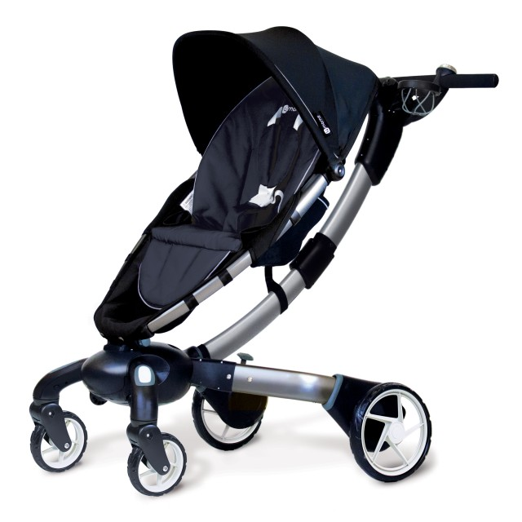
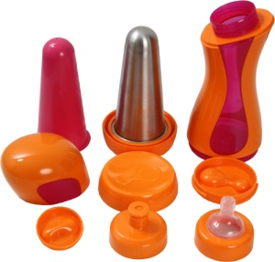
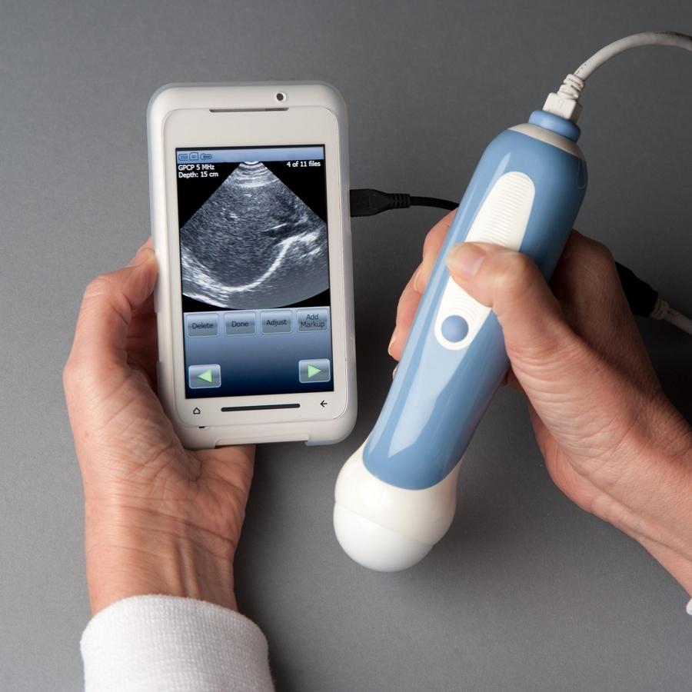
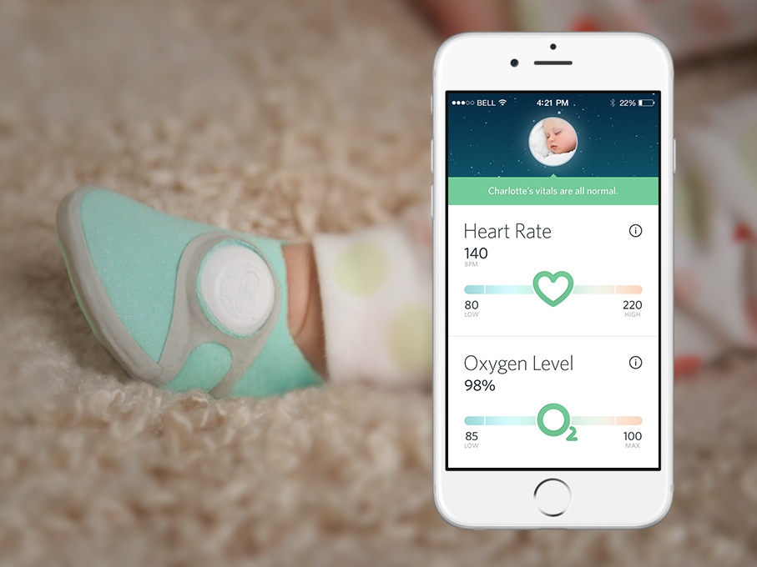
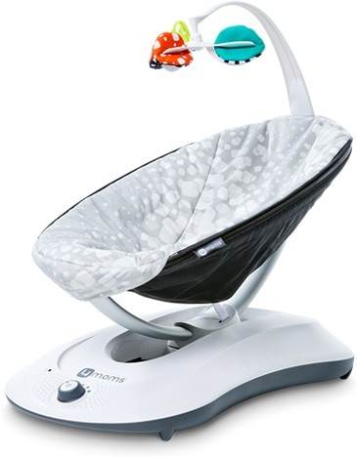
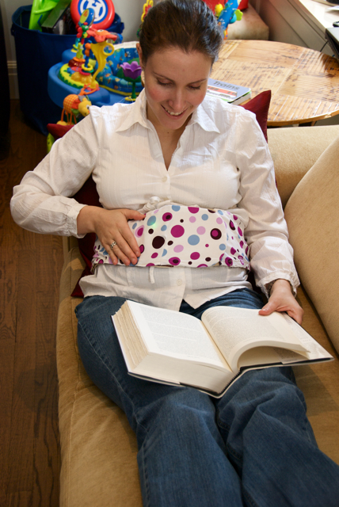
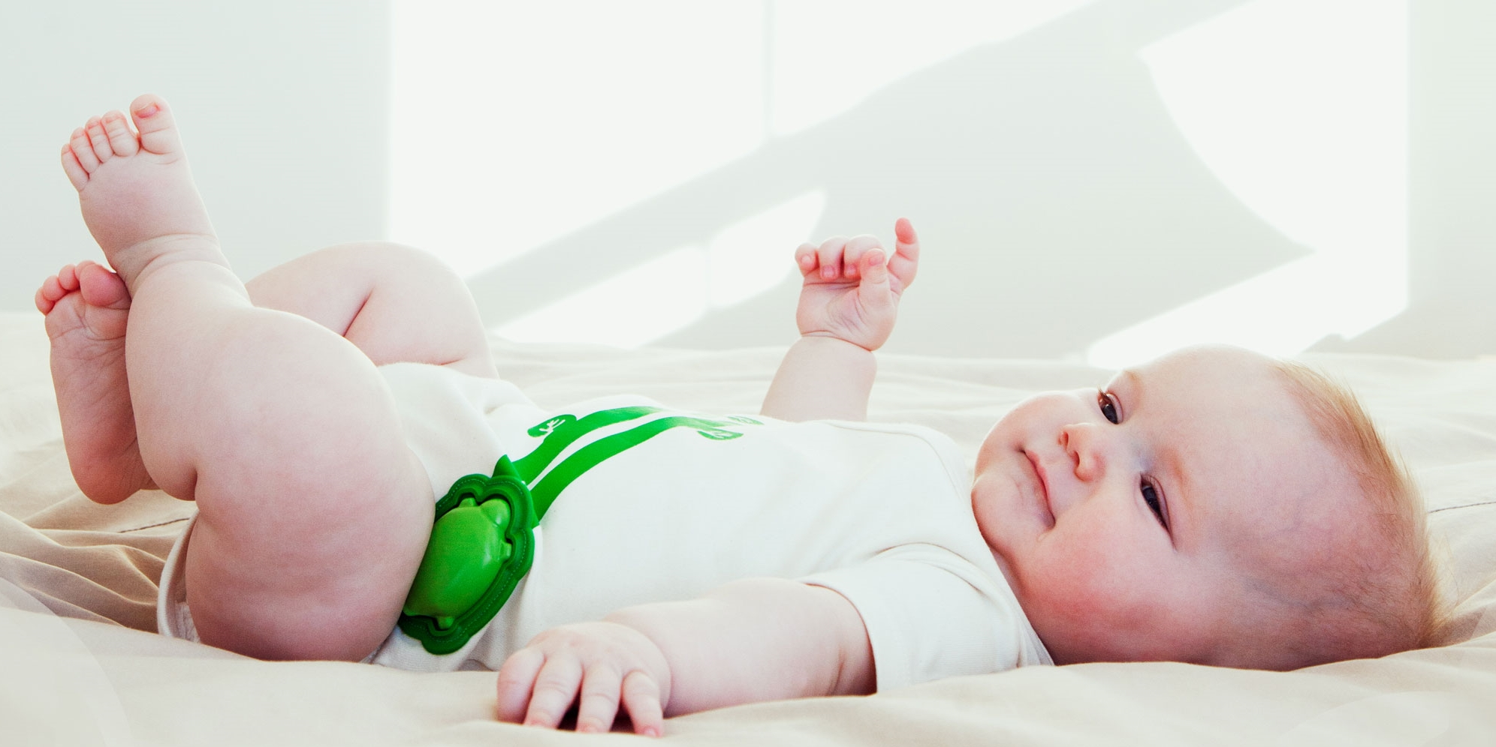
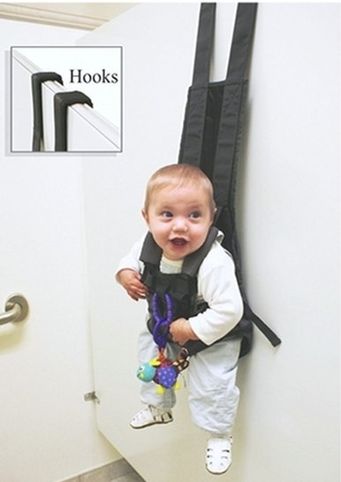
Geek Out
⬅
Self Closing Stroller $850
Self Warming Bottles
$35
Phone Ultrasound
$7,500
Pulse Oximetry Boot
$250
Human like Rocker
$159
Baby Tweet $$
Baby Onesie Monitor
$200
Baby Restroom Hanger
$40
Notes:
Self closing strollers with phone charger, and wheels which generate power
Origami Power-Folding stroller
Self warming bottles
iiamo Go
Salt and water – heating cartridge
Your own ultrasound, works with smart phone
The MobiUS SP1 System
Baby monitor with pulse oximetry boot, get heart rate and oxygen content of baby
Owlet care
Baby bouncer that moves like a human
Rackaroo
Baby band which senses when baby kicks in belly and tweets it out
Kickbee
Bluetooth onesie tells you movement of baby and heart rate
Mimo
Hang your baby up like a coat while using the restroom
The Babykeeper Basic
Extra – Not Pictured
Bluetooth pacifier, get babies temperature and usage
Make a Raspberry Pi audio or video monitor
Arduino interactive child’s mobile

Slide 22
Career

Notes:
With your new time constraints how can you stay up to date with new technologies.

Slide 23
Planning

Notes:
Planning for your extended time off
Goal is to reduce impact on your team

Slide 24
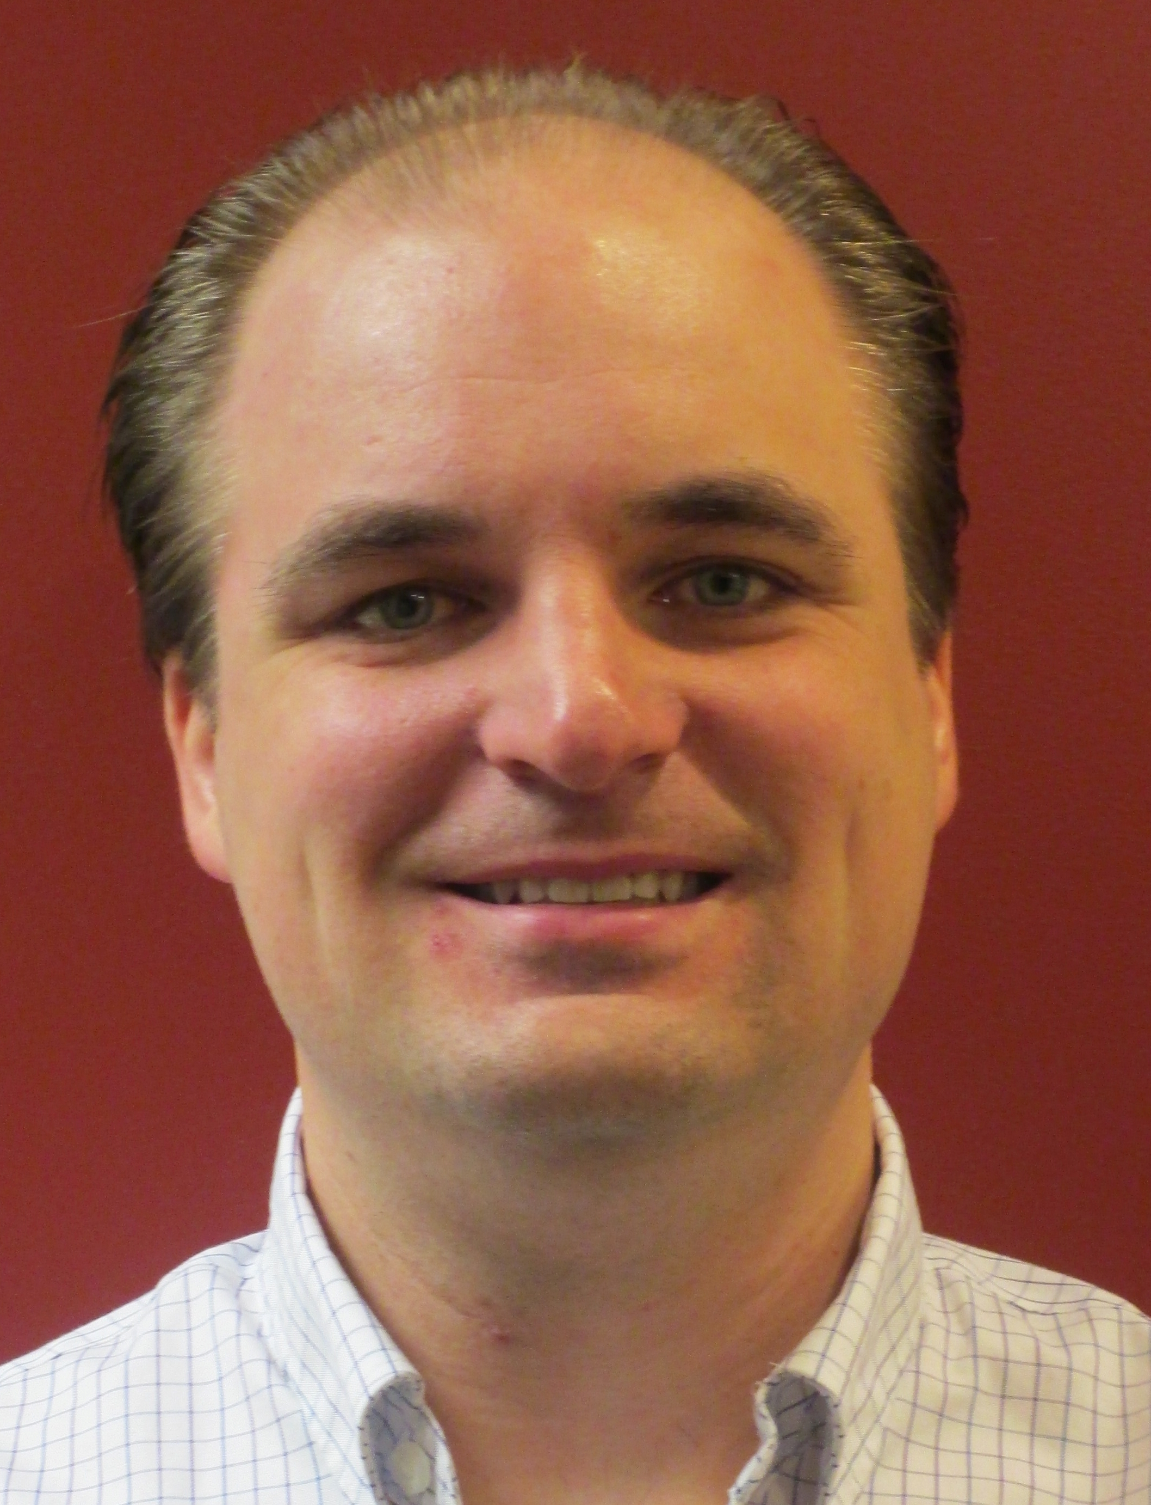
Planning

Your Rights
Communication
Support

⑥

FMLA
Paternity/Maternity leave policy
Short Term Disability policy
babycenter.com/maternity-leave-checklist
Talk to boss first
Form plan with stakeholders
Inform coworkers
Discuss your level of support while out
Relationships
Remove Yourself
Express Appreciation
⑩


Create good will
Lean on people while sleep deprived
Don’t be primary
Take on small projects
Important to keep support from coworkers
Thanks Ben!
Notes:
You will be less productive in the early days of your new child, take the opportunity before the baby is born to create some good will on your team.
Take an undesirable assignment
Work on your relationships with co-workers
Bring in bagels
Get a baby pool started
Create some buzz around the arrival of your new little one
In my experience if you give people enough warning of the changes that will occur they are very supportive and excited for you
Remove yourself as primary on anything
Help others prepare to take on your responsibilities
Documentation of roles
as you get closer to the delivery date, begin taking on non-critical tasks
At the end of the day ensure someone knows where you are on tasks

Slide 25
Get Organized

Notes:
The new reality…you have less time

Slide 26





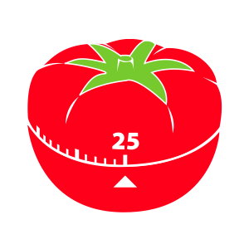
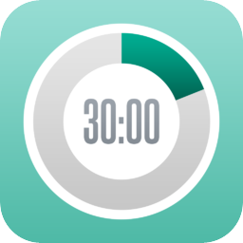
Get Organized


Sunrise
LastPass
Unroll.Me
PWOP
Todoist
Outlook
Pomodoro
30/30
Notes:
My brain is toast…on 4-6 hours of interrupted sleep
Password Manager – I can barely remember my home address
I like LastPass and 1Password, but use LastPass
All platforms…easy to use
Pomodoro Techniques
This fits well for my attention span 25 minutes of work with a short 5 min break in between
After 4 cycles take a longer break.
To Get into the Flow
“Music to Code By” – Carl Franklin
Like it b/c each segment is pomodoro length
60 – 80 beats per minute instrumental only
Now we have ways to capture what we need to do and do it, how can we stay current on technology

Slide 27
Staying Current


Slide 28
Staying Current

A
A
Aggregators
B
B
Experts
C
Newbies
C
Notes:
A Three Pronged Approach to staying current
Aggregators
Bring in diverse topics
General technology podcasts (.net rocks, Distributed Computing)
Conferences (Stir Trek, Code Mash)
User Groups (.Net, Java, Scala, Javascript)
General Blogs (Coding Horror, LosTechies)
Experts
Know the topic inside and out
People (Udi Dahan, Greg Young, Eric Evans, Alistar Cockburn, Robert Martin)
Books (DDD, Effective Java, Perl, Elixir)
Blog Series
Newbies
People who are learning the topic and sharing as they learn
Lots of valuable information coming from newbies
Good Insights
Intro to lingo
Example (Julie Lerman on DDD)

Slide 29
Staying Current

Staging Content:
Gather sources on a topic


·








Notes:
You have some time before the baby is born, pick some technologies and start gathering content:
Books, podcasts, pluralsight, youtube videos, blogs, industry leaders
Once you have the bookmarks, downloaded material, links, and all your content gathered together you are set

Slide 30








Staying Current

·



−

H



Notes:
Consuming Staged Content
When you are holding the baby or doing chores around the house you can learn some of your staged content
I invested in a set of Bluetooth head phones and a tablet, so I am mobile and can watch videos about programming
NDC or other conferences
Pluralsight
When taking my lunch break at work…I get a break from my project and read some on a device or physical book
Before I go to bed I like to wind down with a technical book
On my way to work I will listen to a podcast in the car
Also will listen to podcast while doing chores.
Provided some ideas…how to actually use it

Slide 31
Daily Workflow

Notes:
Wake in the morning usually by my son slapping me in face…
Make breakfast get the family moving
Check the calendar and TODO list – get plan for the day started in my head
Get ready to commute start up podcast
Get to work check email … add todos
Execute a Pomodoro
Do standup…add Adjust TODO’s
Organize rest of day
Execute Pomodoro
Get back with people who interrupted
Adjust TODO’s
Pomodoro
Lunch – Read book
Listen to Music to code by while doing Pomodoros
Finish Podcast on way home from work
Dinner and family time
Put kids to bed
Watch pluralsight or other video while doing some chores
Time with wife
Read in bed
Sleep
Wake up to spend more time with baby ☺

Slide 32
Children & Technology


Slide 33
Screen Time

Notes:
How much screen time should be give our children?

Slide 34
Screen Time

⇨
AAP Recommends
Younger than 2 years old – No Screen Time
2 to 18 years old – Limit to 2 hours per day
Notes:
Effects of too much screen time
American Academy of Pediatrics recommendations for screen time and why
No more than 2 hours per day

Slide 35
Doctors Don’t Know Nothing
⇨
Notes:
I have a lot Dr’s in my family and I don’t trust any advice as far as technology is concerned
As I would hope they would not advice from me on medical issues
I want to ensure my kid has a leg up by having access to technology
Can you imagine what we would know now, if we had the technology we have today when we were kids?

Slide 36
From the Corner Office

Notes:
There is an interesting article “Steve Jobs Was a Low-Tech Parent” in the New York Times by Nick Bilton, who assumingly asked Steve Jobs, “So your kids must love the iPad?” Jobs responded: “They haven’t used it. We limit how much technology our kids use at home.”
Ok admittedly Steve Jobs could be a bit of an odd duck.

Slide 37
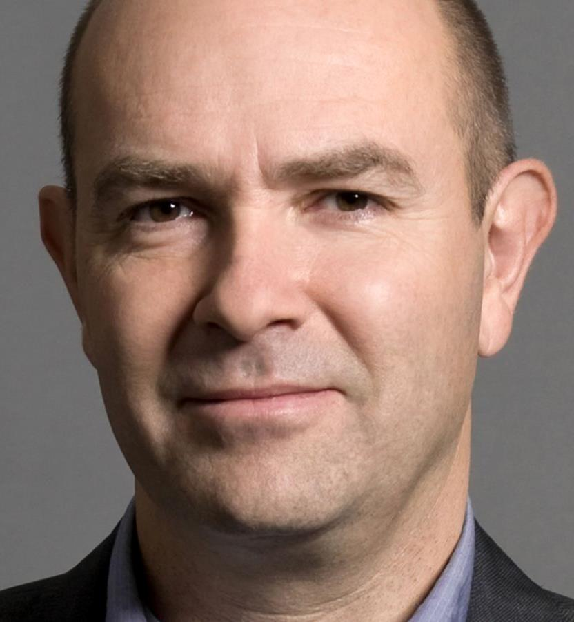
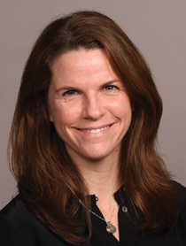
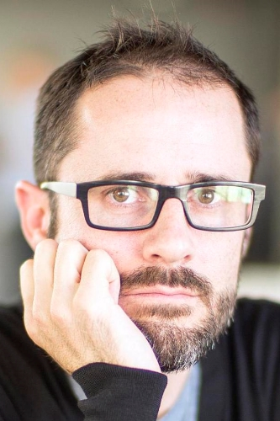


From the Corner Office


Chris Anderson
Alex Constantinople
Evan Williams

Chief Exec of 3D Robotics, former editor of Wired.
Kids accuse him of being a fascist and overly concerned about tech.

Chief exec of the OutCast Agency, a tech-focused communications & marketing firm.
On school nights kids only get 30 min on gadgets.

A founder of Blogger, Twitter and Medium.
In lieu of iPads, their 2 young boys have hundreds of books (yes, physical ones)



Notes:
Chris Anderson
“My kids accuse me and my wife of being fascists and overly concerned about tech, and they say that none of their friends have the same rules,” he said of his five children, 6 to 17. “That’s because we have seen the dangers of technology firsthand. I’ve seen it in myself, I don’t want to see that happen to my kids.”
Alex Constantinople
said her youngest son, who is 5, is never allowed to use gadgets during the week, and her older children, 10 to 13, are allowed only 30 minutes a day on school nights.
Evan Williams a founder of Blogger, Twitter and Medium, and his wife, Sara Williams, said that in lieu of iPads, their two young boys have hundreds of books (yes, physical ones) that they can pick up and read anytime.

Slide 38
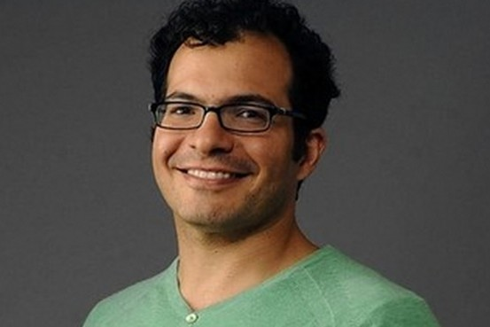
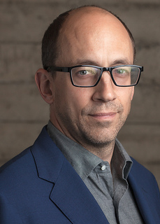
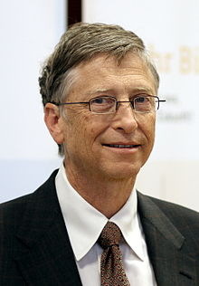
From the Corner Office




Ali Partovi
Dick Costolo
Bill Gates

A founder of iLike and adviser to Facebook, Dropbox and Zappos.
Distinction between consuming and creating on screens.

The chief executive of Twitter.
Allows unlimited use of gadgets as long as their two teenagers are in the living room.

The Microsoft founder.
Limit of 45 minutes of screen time during the week and 60 minutes on weekends.



Notes:
Ali Partovi
A founder of iLike and adviser to Facebook, Dropbox and Zappos, said there should be a strong distinction between time spent “consuming,” like watching YouTube or playing video games, and time spent “creating” on screens.
Dick Costolo
The chief executive of Twitter, told me he and his wife approved of unlimited gadget use as long as their two teenage children were in the living room. They believe that too many time limits could have adverse effects on their children.
Others said that outright bans could backfire and create a digital monster.
Bill Gates
Gates said he and his wife Melinda decided to set a limit of 45 minutes a day of total screen time for games and an hour a day on weekends, plus what time she needs for homework.

Slide 39
Screen Time Stats
⓪
Notes:
Current State of Affairs

Slide 40
Screen Time Stats
⓪
Source: Common Sense Media: 0-8 Children’s Media use in America 2013
https://www.commonsensemedia.org/research/zero-to-eight-childrens-media-use-in-america-2013
Notes:
Common Sense Media
See a large increase in the use of mobile devices
0-8 year olds

Slide 41
Screen Time Stats
⓪
Source: Common Sense Media: 0-8 Children’s Media use in America 2013
https://www.commonsensemedia.org/research/zero-to-eight-childrens-media-use-in-america-2013

Slide 42
Concerns


Slide 43
Concerns

Obesity
Behavior
Violence
Sleep
School
Bullying
Addiction
Adult Content
Play Time
Notes:
Previously mentioned side effects noted by AAP
Obesity
Exposure to more food marketing
Lack of movement
Kindergartners and first-graders who watched even an hour of television a day were more likely to be overweight or obese
Behavioral Problems
Violence – due to desensitization
Irregular Sleep
I certainly don’t want to contribute to a lack of sleep.
Poor Academic Performance
Limit exposure to harmful content
Think adult content
Bullying from other kids
Addiction to Devices
Reduction in fine motor skills, due to too much time with touch devices
Preschool teacher story
Be wary of complete removal of devices, it may cause a binge behavior when they do not have limits
Increase creativity
They may not need to drive their own cars, but they will need to interact with other humans
Software teams are a lot about team dynamics and social skills, how can we ensure our kids are social

Slide 44
How to Manage Technology

Notes:
What strategies can we use to reduce screen time and mitigate concerns?

Slide 45
How to Manage Technology




Keep it Out of the Bedroom
Don’t Eat in Front of TV
Set School Day Rules

⑦

Suggest other activities
Set a Good Example
Unplug it
Notes:
Holy Macaroni and cheese sickles
Differentiate passive consumption from creation time, which is similar to playing piano or writing
Ali Partovi
Provide other habits, family exercise, reading physical books
encourage active screen time, jumping jacks on commercial
Don't use screen time as reward or punishment, b/c makes devices seem more important

Slide 46
Digital Guardian

Notes:
You will need to give your children access to technology, for school work, to socialize
How can you help guide your kids in the right direction with the use of technology?

Slide 47

Digital Guardian

②

Social Media



①
↑
Notes:
As a parent you are responsible for protecting your child’s “digital footprint” and digital identity
How do we manage our children's digital persona?
It is important to think about your child’s privacy rights when posting about them online
Too much sharing of your child’s information could lead to identity theft, child’s date of birth, full name, location, and other info
Marketer’s could use this information
Get permission before posting pictures of other peoples kids
Ensure you have your privacy settings set correctly on your social media applications
As developers we need to ensure our software provides opportunity for differing levels of security and privacy
Ephemeral Social Media apps
Snapchat
Facebook tried with Poke App but pulled it
Some parent’s forbid usage of other social media apps b/c SnapChat deletes messages
Geo Location concerns

Slide 48
Digital Guardian

1
2
3
Set Reasonable Expectations
Talk with your kids about how they use services
Support Critical thinking and civil behavior
4
5
Require Internet use in a high-traffic place
Get your kids to share
Notes:
Be reasonable and try to set reasonable expectations.
Pulling plug on favorite social site like killing social life
talk with your kids about how they use the services
Online safety, keep things private (passwords) personal information
Don’t every meet anyone you don’t know in real life
Support critical thinking and civil behavior
Help child develop good sense about safety and relationships
Be good citizens online
Consider requiring Internet use in a high-traffic place in your home
Not allow in their room alone
Try to get your kids to share their profiles and blogs with you
Be aware your kids could sign up a new profile
Google info about your kids every once in a while

Slide 49
Teaching Our Kids

Notes:
What applications do we let our children use and what do we hope it will teach them?
Ali Partovi – distinguished creative activities vs consumption activities
Reading apps
Physiology apps
Math apps
One category of creative apps is coding apps

Slide 50




Teaching Our Kids

HOPSCOTCH
Kodable
Scratch
Scratchjr
IOS App
gethopscotch.com
IOS App
Online or PC Game
kodable.com
Online or PC Game
IOS App
Android App
scratchjr.org
scratch.mit.edu
Notes:
Note Scratch does not have IOS or Android App only Scratch

Slide 51
Summary
>



Notes:
How Technology Can assist from pregnancy through the first days of child's life
How manage career expectations, time, and continuous learning (How to remain effective in your career while still spending time with your family)
Discussion of topics related to children and technology
Pull it together: Having a baby is a wonderful experience, which impact your life in many ways, with some planning and hard work you can be successful in parenting and your career

Slide 52
Resources


Slide 53
Resources

① https://twitter.com/CognitiveBurden
 https://github.com/cognitiveburden
 cognitiveburden@gmail.com
 bit.ly/CodingWithABaby
Jim Everett
Developer, Architect, Software Enthusiast

Slide 54
Resources

Having the Baby
Pregnancy:
http://www.babycenter.com/pregnancy
https://itunes.apple.com/us/app/my-pregnancy-today-babycenter/id386022579?mt=8
https://itunes.apple.com/us/app/50-000-baby-names-free/id363724891?mt=8
https://itunes.apple.com/us/app/happy-pregnancy-ticker/id449267797?mt=8
https://itunes.apple.com/us/app/full-term-labor-contraction/id382013176?mt=8
https://itunes.apple.com/us/app/baby-names!!/id412443566?mt=8
http://www.babybookie.com/
Delivery:
https://www.bornyet.com/
http://www.birthvillage.com/birth-announcements.php
Early Years
http://mammababy.lifenstats.com
http://makesafehappen.com/
http://dayoneapp.com/
https://www.lifecake.com/
Geek Out
http://www.pcmag.com/slideshow/story/308706/11-tech-gadgets-for-new-parents
http://www.iiamo.com/products/iiamo-go-family/go/
http://www.oddee.com/item_98567.aspx
https://www.4moms.com/origami
http://www.mobisante.com/products/product-overview/
https://www.owletcare.com/
https://www.4moms.com/rockaroo
http://www.oddee.com/item_98567.aspx
http://wdc.com/ventito/tech/trending/the-wired-baby-5-innovative-gadgets-for-new-parents
http://mattkaar.com/blog/2012/12/01/raspberry-pi-as-a-baby-monitor/
http://stuffbabiesneed.com/blog/building-raspberry-pi-baby-monitor-part-one/
http://blog.alexwilde.net/make-a-raspberry-pi-baby-monitor/
http://duino4projects.com/interactive-childs-mobile-using-arduino/
http://mimobaby.com/

Slide 55
Resources

Career
Planning:
http://www.babycenter.com/maternity-leave-checklist
Career:
http://lifehacker.com/how-to-prepare-your-career-before-having-a-baby-1686911785
https://todoist.com/
https://calendar.sunrise.am/
http://3030.binaryhammer.com/
https://itunes.apple.com/us/app/microsoft-outlook/id951937596?mt=8
http://pomodorotechnique.com/
http://mtcb.pwop.com/
http://dotnetrocks.com/
http://distributedpodcast.com/
http://hanselminutes.com/

Slide 56
Resources

Children With Technology
http://lifehacker.com/5946947/how-can-i-kid-proof-my-pc-and-gadgets
https://www.aap.org/en-us/advocacy-and-policy/aap-health-initiatives/pages/media-and-children.aspx
http://www.nhlbi.nih.gov/health/educational/wecan/reduce-screen-time/tips-to-reduce-screen-time.htm
http://www.nytimes.com/2014/09/11/fashion/steve-jobs-apple-was-a-low-tech-parent.html
http://theunboundedspirit.com/why-steve-jobs-didnt-let-his-kids-use-ipads/
http://waldorfpeninsula.org/
http://www.telegraph.co.uk/education/educationnews/10767878/Infants-unable-to-use-toy-building-blocks-due-to-iPad-addiction.html
http://www.sensomotorische-integratie.nl/CrisRowan.pdf
http://richardfreed.com/wired-child/
http://www.nytimes.com/2011/10/25/us/screen-time-higher-than-ever-for-children-study-finds.html
https://www.commonsensemedia.org/
http://www.parentfurther.com/resources/enewsletter/e-parenting
http://www.bluemanateebooks.com/home/digital_playground_data/screen_time_trends.html
https://www.parentmap.com/article/are-kids-watching-less-common-sense-media-study-spotlights-screen-time-trends
https://itunes.apple.com/us/app/kids-media/id504932051?mt=8
https://www.commonsensemedia.org/research/zero-to-eight-childrens-media-use-in-america-2013 http://www.cnn.com/2015/04/29/health/kindergartners-tv-weight-gain/index.html
Digital Guardian
https://www.commonsensemedia.org/privacy-and-internet-safety/how-do-i-protect-my-kids-privacy-online
http://www.coppa.org/
https://www.snapchat.com/safety
http://www.connectsafely.org/wp-content/uploads/snapchat_parents_guide.pdf
http://www.ikeepsafe.org/
http://www.saferinternet.org.uk/
http://www.connectsafely.org/
http://www.connectsafely.org/wp-content/uploads/sc_cyberbullying.pdf
http://www2.ed.gov/policy/gen/guid/fpco/ferpa/index.html
How to teach coding
http://allthingsd.com/20130506/can-these-ipad-apps-teach-your-kid-to-code/
https://itunes.apple.com/us/app/kodable/id577673067?mt=8
https://itunes.apple.com/us/app/hopscotch-hd/id617098629?mt=8
http://www.edutopia.org/blog/7-apps-teaching-children-coding-anna-adam
https://scratch.mit.edu/
https://www.gethopscotch.com/
https://www.kodable.com/
http://www.scratchjr.org/

